Slide 1
MODERNIZATION OF MICROSERVICES
AWS GRAPHQL MANAGED SERVICE IS PERFECT EXAMPLE

Slide 2
AWS APPSYNC - What is AWS AppSync? – SYSTEM DESIGN
AWS AppSync is a fully managed service that simplifies the development of GraphQL APIs by allowing you to easily connect applications to data sources. It enables real-time data synchronization and offline capabilities, making it ideal for building modern applications.

Slide 3
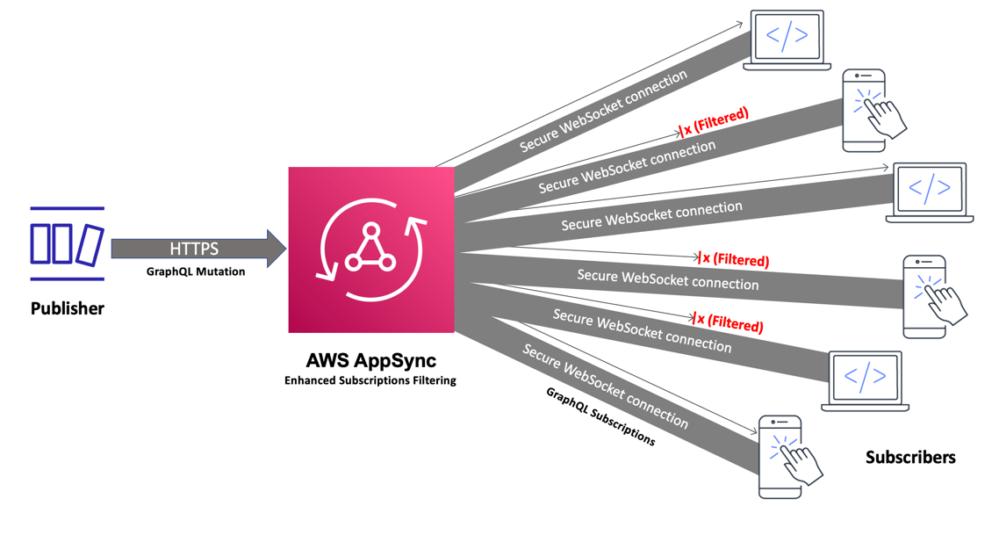
WHAT IS AWS APPSYNC – SYSTEM DESIGN

Slide 4
WHAT IS AWS APPSYNC
AWS AppSync enables developers to connect their applications and services to data and events with secure, serverless and high-performing GraphQL and Pub/Sub APIs. You can do the following
with AWS AppSync:

Slide 5
What IS AWS APP SYNC
Access data from one or more data sources from a single GraphQL API endpoint.
• Combine multiple source GraphQL APIs into a single, merged GraphQL API.
• Publish real-time data updates to your applications.
• Leverage built-in security, monitoring, logging, and tracing, with optional caching for low Latency
• Only pay for API requests and any real-time messages that are delivered.

Slide 6
AWS AppSync features
• Simplified data access and querying, powered by GraphQL
• Serverless WebSockets for GraphQL subscriptions and pub/sub channels
• Server-side caching to make data available in high speed in-memory caches for low latency
• JavaScript and TypeScript support to write business logic
• Enterprise security with Private APIs to restrict API access and integration with AWS WAF
• Built in authorization controls, with support for API keys, IAM, Amazon Cognito, OpenID Connect providers, and Lambda authorization for custom logic.
• Merged APIs to support federated use cases

Slide 7
Key features
Key Features of AWS AppSync:
GraphQL API: AppSync allows you to define a GraphQL schema that enables clients to request only the data they need, optimizing data retrieval.
Data Sources: It can integrate with various data sources, including:
Amazon DynamoDB
AWS Lambda
Amazon RDS
HTTP APIs
Elasticsearch
Real-time Data: AppSync supports real-time subscriptions, allowing clients to receive updates automatically when data changes.

Slide 8
KEY FEATURES
Real-time Data: AppSync supports real-time subscriptions, allowing clients to receive updates automatically when data changes.
Offline Capabilities: With built-in offline support, AppSync enables applications to continue functioning when not connected to the internet, syncing changes once the connection is restored.
Security: AppSync integrates with AWS Identity and Access Management (IAM), Amazon Cognito, and API keys for authentication and authorization.
Monitoring and Logging: It provides built-in monitoring and logging features via Amazon CloudWatch, allowing you to track API usage and performance.

Slide 9
USE CASES
Use Cases:
Building scalable applications with dynamic data needs.
Creating real-time applications like chat or collaboration tools.
Developing mobile and web applications that require offline functionality.

Slide 10
SIMPLE STEPS TO CREATE
Define your GraphQL schema.
Connect your data sources.
Set up authentication and authorization.
Implement your client application to interact with the GraphQL API.
AWS AppSync streamlines the process of building and managing APIs, making it a powerful tool for developers looking to create feature-rich applications.

